Slide 1
CD NOZZLE ANALYSIS
By: Aditya Potdar

Slide 2

Blasius Boundary Layer Solution
Ludwig Prandtl developed the boundary layer theory which states that for a flow around a body of high Reynolds number, the flow regime can be divided into two categories, one is the viscous layer near the surface and a region outside where viscosity is negligible.
It works on the principle of no-slip condition.
Blasius later on, went on to find a solution to the boundary layer equations which describes the flow inside the boundary layer.
Following assumption is made to derive the boundary layer equations from the NS equations.

Slide 3
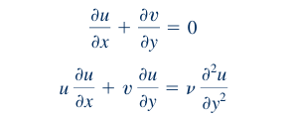




Blasius Boundary Layer Solution
Boundary Layer Governing Equation
Assumptions to the Boundary Layer equation
By applying a clever coordinate transformation and change of variables, Blasius reduced the partial differential equations to an ordinary differential equation that he was able to solve.
Using the definition of the stream function, u and v are found out which are then substituted in the boundary layer governing equation. After considerable manipulation the following nonlinear, third-order ordinary differential equation.

Slide 4



Blasius Boundary Layer Solution
The following boundary conditions are then applied to the ODE and solved computationally to obtain the dimensionless Boundary Layer Profile.
Where, f prime and eta analogous to velocity and y distance.
Having understood the Blasius Boundary Layer Solution, it was time to produce the profile using Ansys Fluent and then compare it with a profile generated using Python. In Fluent a rectangular domain was considered with a height of 0.5m and length of 1m to simulate a flat plate in 2D. The freestream velocity, U = 1m/s. The fluid medium is taken as air.

Slide 5
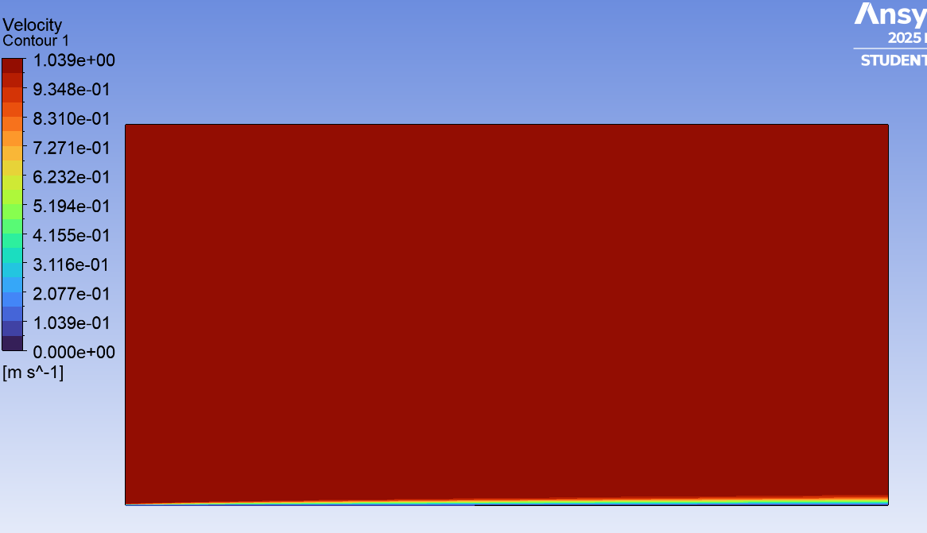
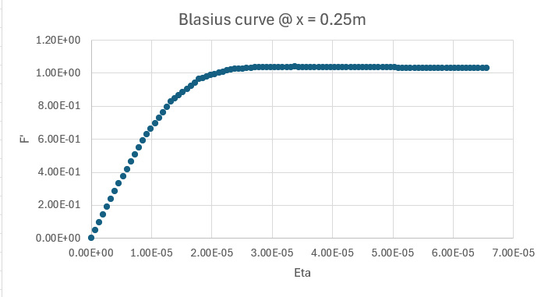
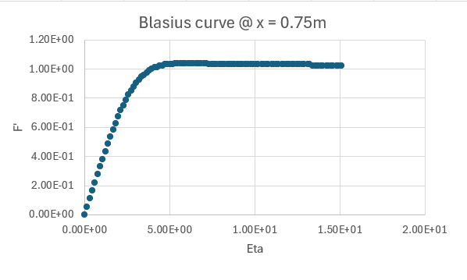
Blasius Boundary Layer Solution
The u velocity values were extracted at x = 0.25m and x = 0.75m and their Blasius profile were plotted.

Slide 6
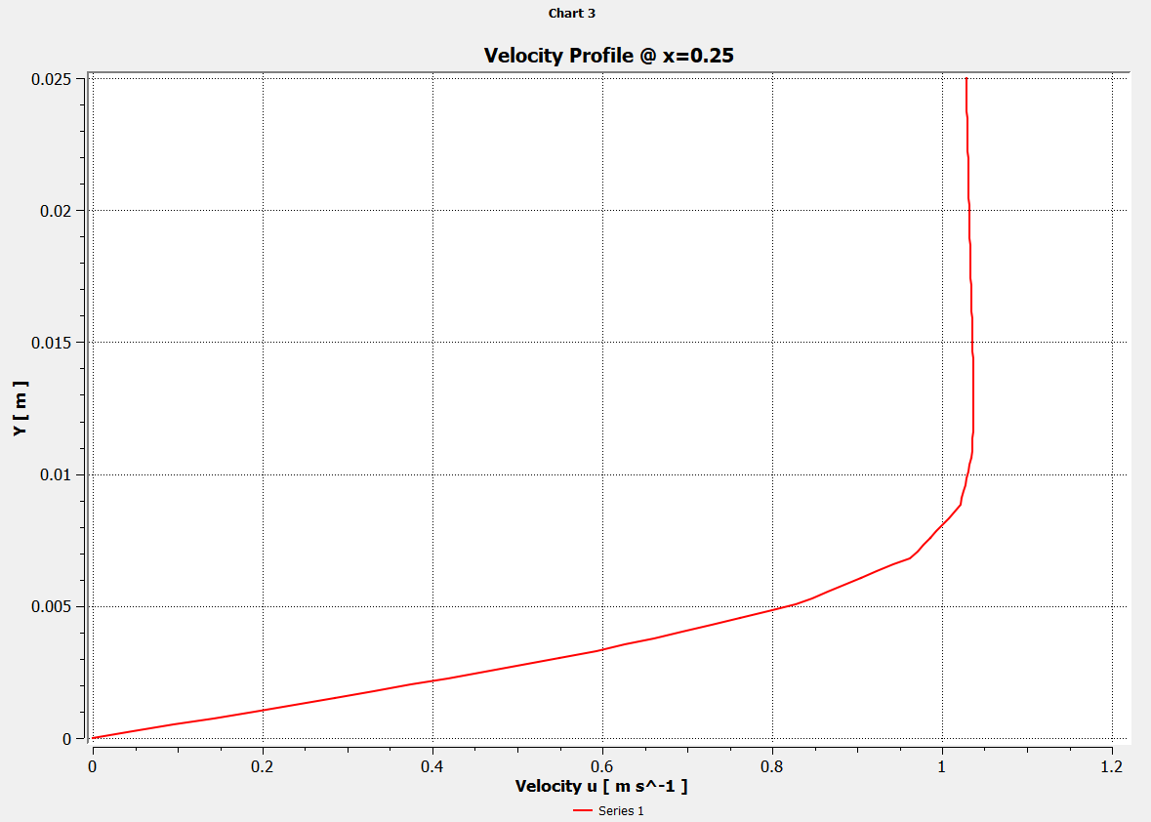
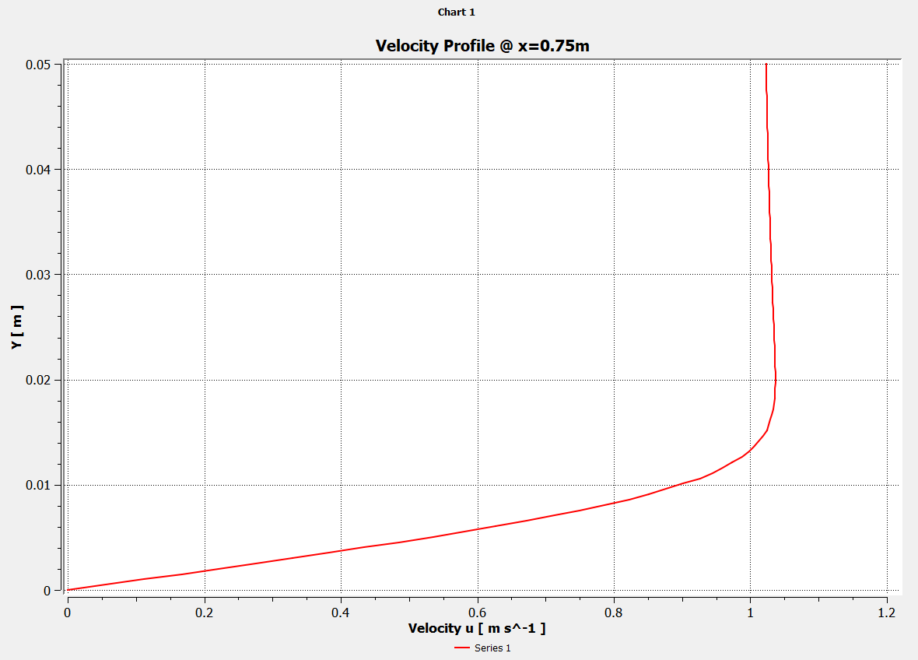
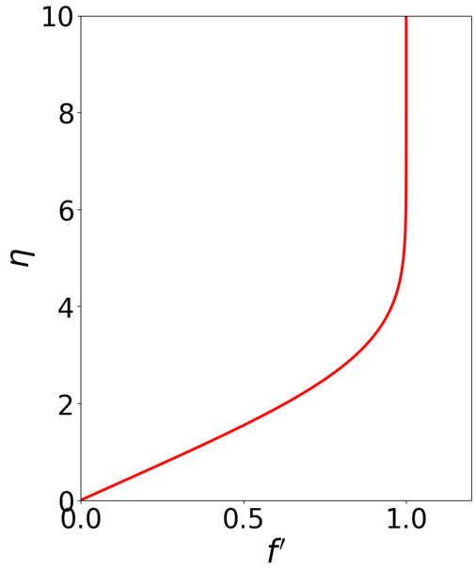
Blasius Boundary Layer Solution
Blasius solution using Python.
Velocity profile @ x = 0.25m
Velocity profile @ x = 0.75m

Slide 7
CD Nozzle Analysis
The Back & Massier paper consists of the experimental investigation of the convective heat transfer from turbulent boundary layers accelerated under the influence of large pressure gradients in a cooled convergent-divergent conical nozzle.
The validity of the SU2 solver is tested by validating the results with the Back & Massier paper.
Two test cases are simulated from the paper. Test no.268 corresponding to perfect expansion and test no. 266 corresponding to normal shock.

Slide 8
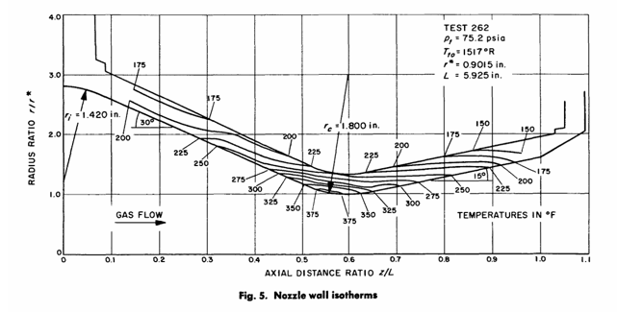
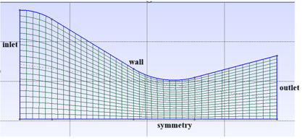
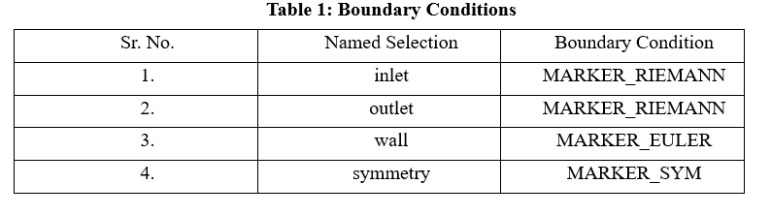
Perfect Expansion Case
Fig 1:Geometry of the nozzle
Fig 2: Coarse Mesh

Slide 9
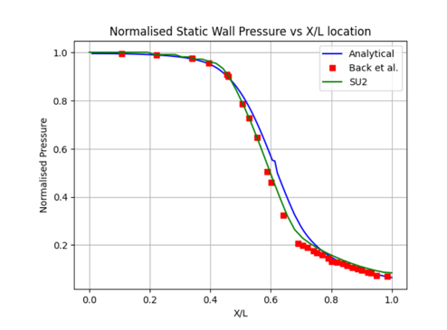
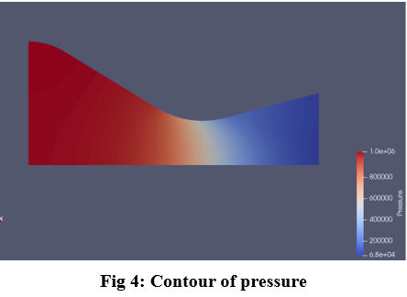
Perfect Expansion Case
The flow is taken as inviscid, thus the Euler equations are solved with the boundary conditions as P0 = 1038350.4 Pa, T0 = 824.44 K and Pb = 59147.39 Pa. Lax Friedrich scheme with Venkatkrishnan slope limiter is used which proved to be the most effective one.
Fig 3: Comparing the SU2 results with the Analytical and Experimental Results

Slide 10
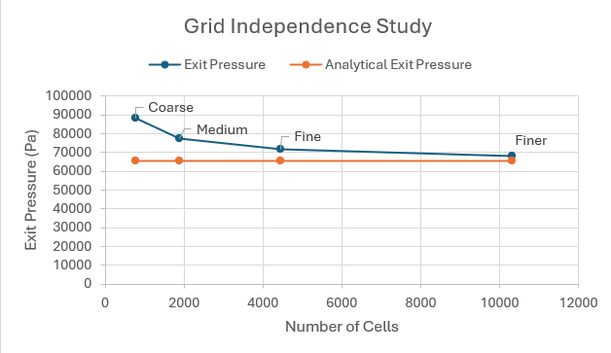
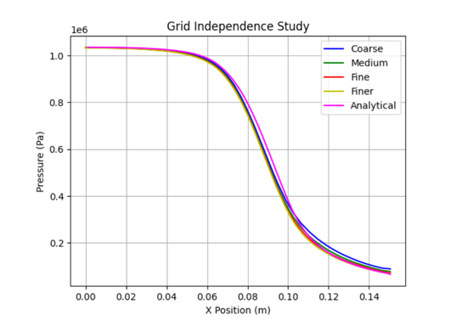
Perfect Expansion Case
(a)
(b)
Fig 5(a) & (b): Grid Independence Study
The fine mesh was considered the most appropriate one and taken for further studies.

Slide 11
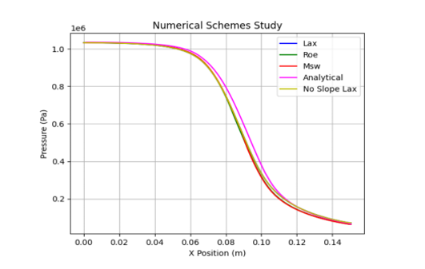
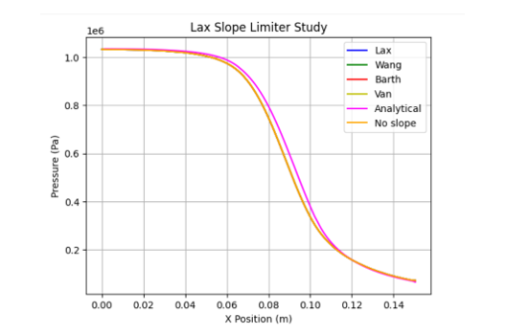
Perfect Expansion Case
The effect of different numerical schemes and slope limiter were studied, Lax and Venkatkrishnan were the best suited one.

Slide 12
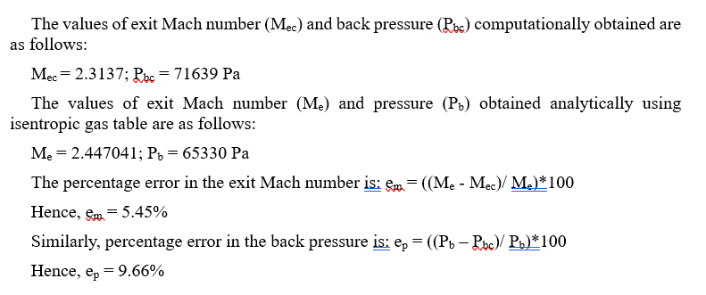
Perfect Expansion Case
The error at the exit plane of the nozzle is calculated.
Hence, SU2 solved the test case appropriately.

Slide 13
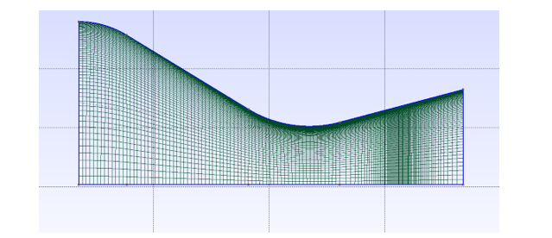
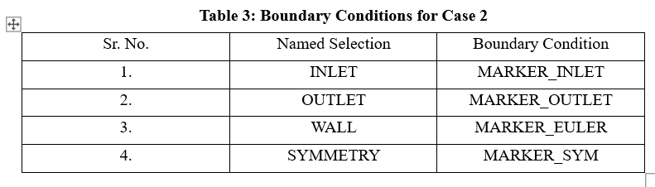
Shock Case
Fig 1: Mesh
The flow is taken as viscous. Thus the mesh is refined at the boundary and at the position of the shock. The value of the boundary conditions applied are P0 = 308885.1 Pa, T0 = 835 and Pb = 92665.53 Pa. Roe convective scheme and Venkatkrishnan slope limiter were applied with SST Menter as the turbulence model and viscosity is taken as constant.

Slide 14
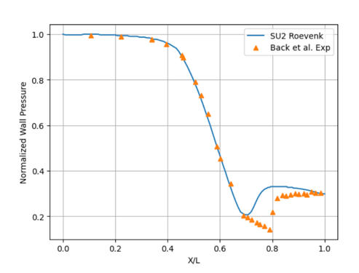
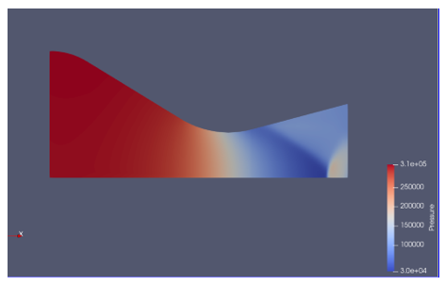
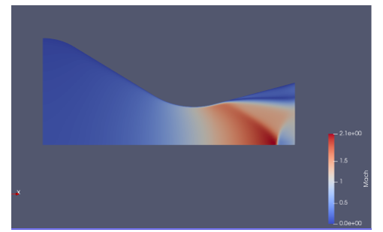
Shock Case
Fig 3: Pressure Contour
Fig 2: Comparison with experimental data
Fig 4: Mach Number Contour

Slide 15
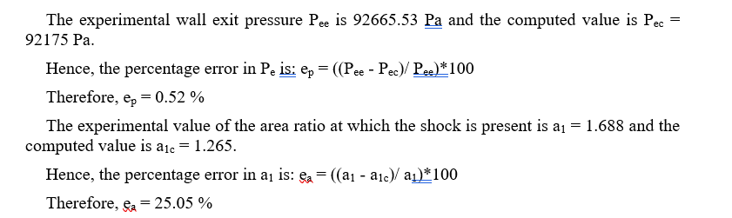
Shock Case
Error at the exit plane is calculated.

Slide 16
Thank You

